Slide 1
Business Model:
Salinity and Climate Map
Chenhao Li, Haoxuan Zhu, Jiaxi Zhou, Yiming Shi, Yongwei Yuan
Shanghai Jiao Tong University
Notes:
Hello everyone, today we wanna introduce the business model for our salinity and climate map. Here is our group member ....

Slide 2
Business Case
What is the problem?
How we address it?
How customer would benefit?
Notes:
First we’ll introduce the business case of our project.
We’ll introduce the existing problem, and the method we might apply to solve the problem. And most importantly how customers can benefit from our project.

Slide 3
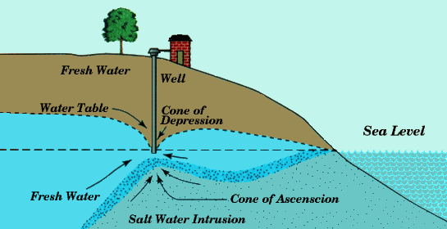
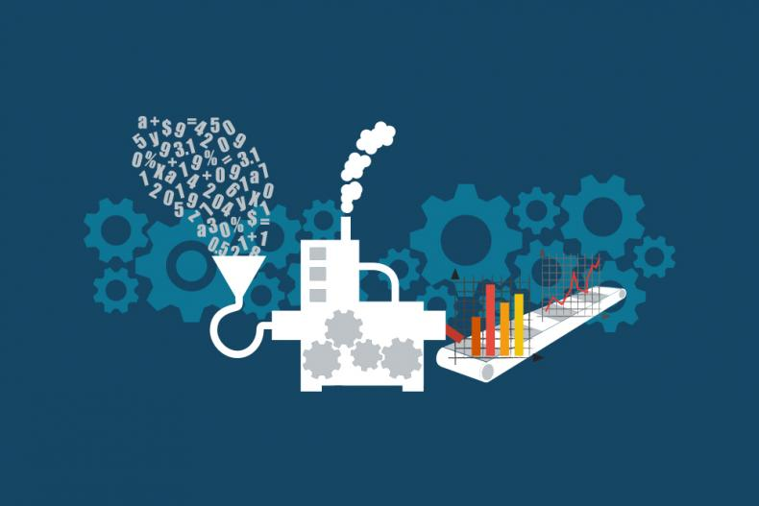
What is the problem?
Notes:
Since at least the start of the 20th century, sea level rise is one of the most severe impacts of climate change. The rising water is threatening to flood small-island nations and coastal regions from many aspects. Even worse, the rising sea level could cause salt water intrusion. That would be a huge problem for those people who live in coastal area and rely on well as their main water resource. The salt would permeate in the well. If people drink this kind of water in their daily life. Consequently, the increasing salt intake could be dangerous to people’s health.
On the other side, scientists have been working on mitigation of the impacts of climate change. But they lack the handy tools to help them process the data collected by various kind of device throughout the world and gain insight from them. There is gap between the real world and the scientific world. We, as engineer, want to build a tool to help bridging this gap.

Slide 4
How we address it?
Notes:
Our approach is interactive maps. The main benefit of interactive maps is that almost everyone can use it without barriers. For those poor people who needs safe water from wells, they can simply use our map as a navigation tool. For those climate change researchers, they can almost get rid of laborious data processing so that they could save time for true research.

Slide 5
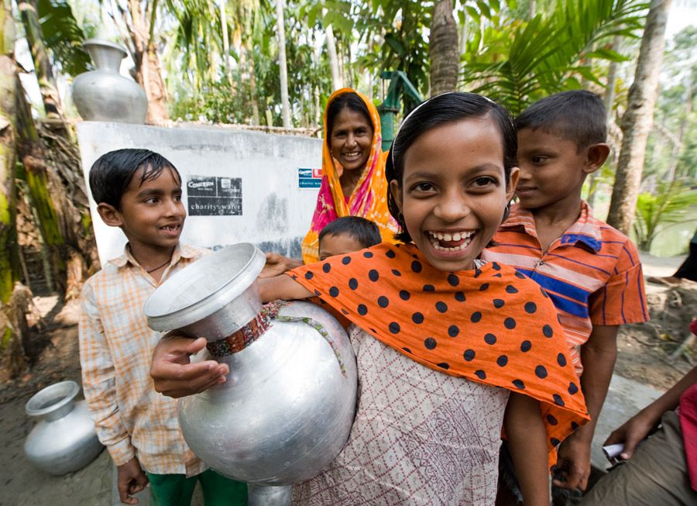

How customer would benefit?
Notes:
In our vision, our customer will benefit a lot from our salinity and climate map. Those people who suffer from high salt intake would be able to drink safer water. And they would stay healthy. On the other side, researchers are happy as well because our tool could do most of the data processing and data visualization for them.

Slide 6
Business Model Canvas
Overview
Value Proposition
Customer Segment
Revenue Resources
Notes:
Next I’ll give a brief overview of our business model canvas. We’ll mainly focus on value proposition, customer segment and revenue resources.

Slide 7
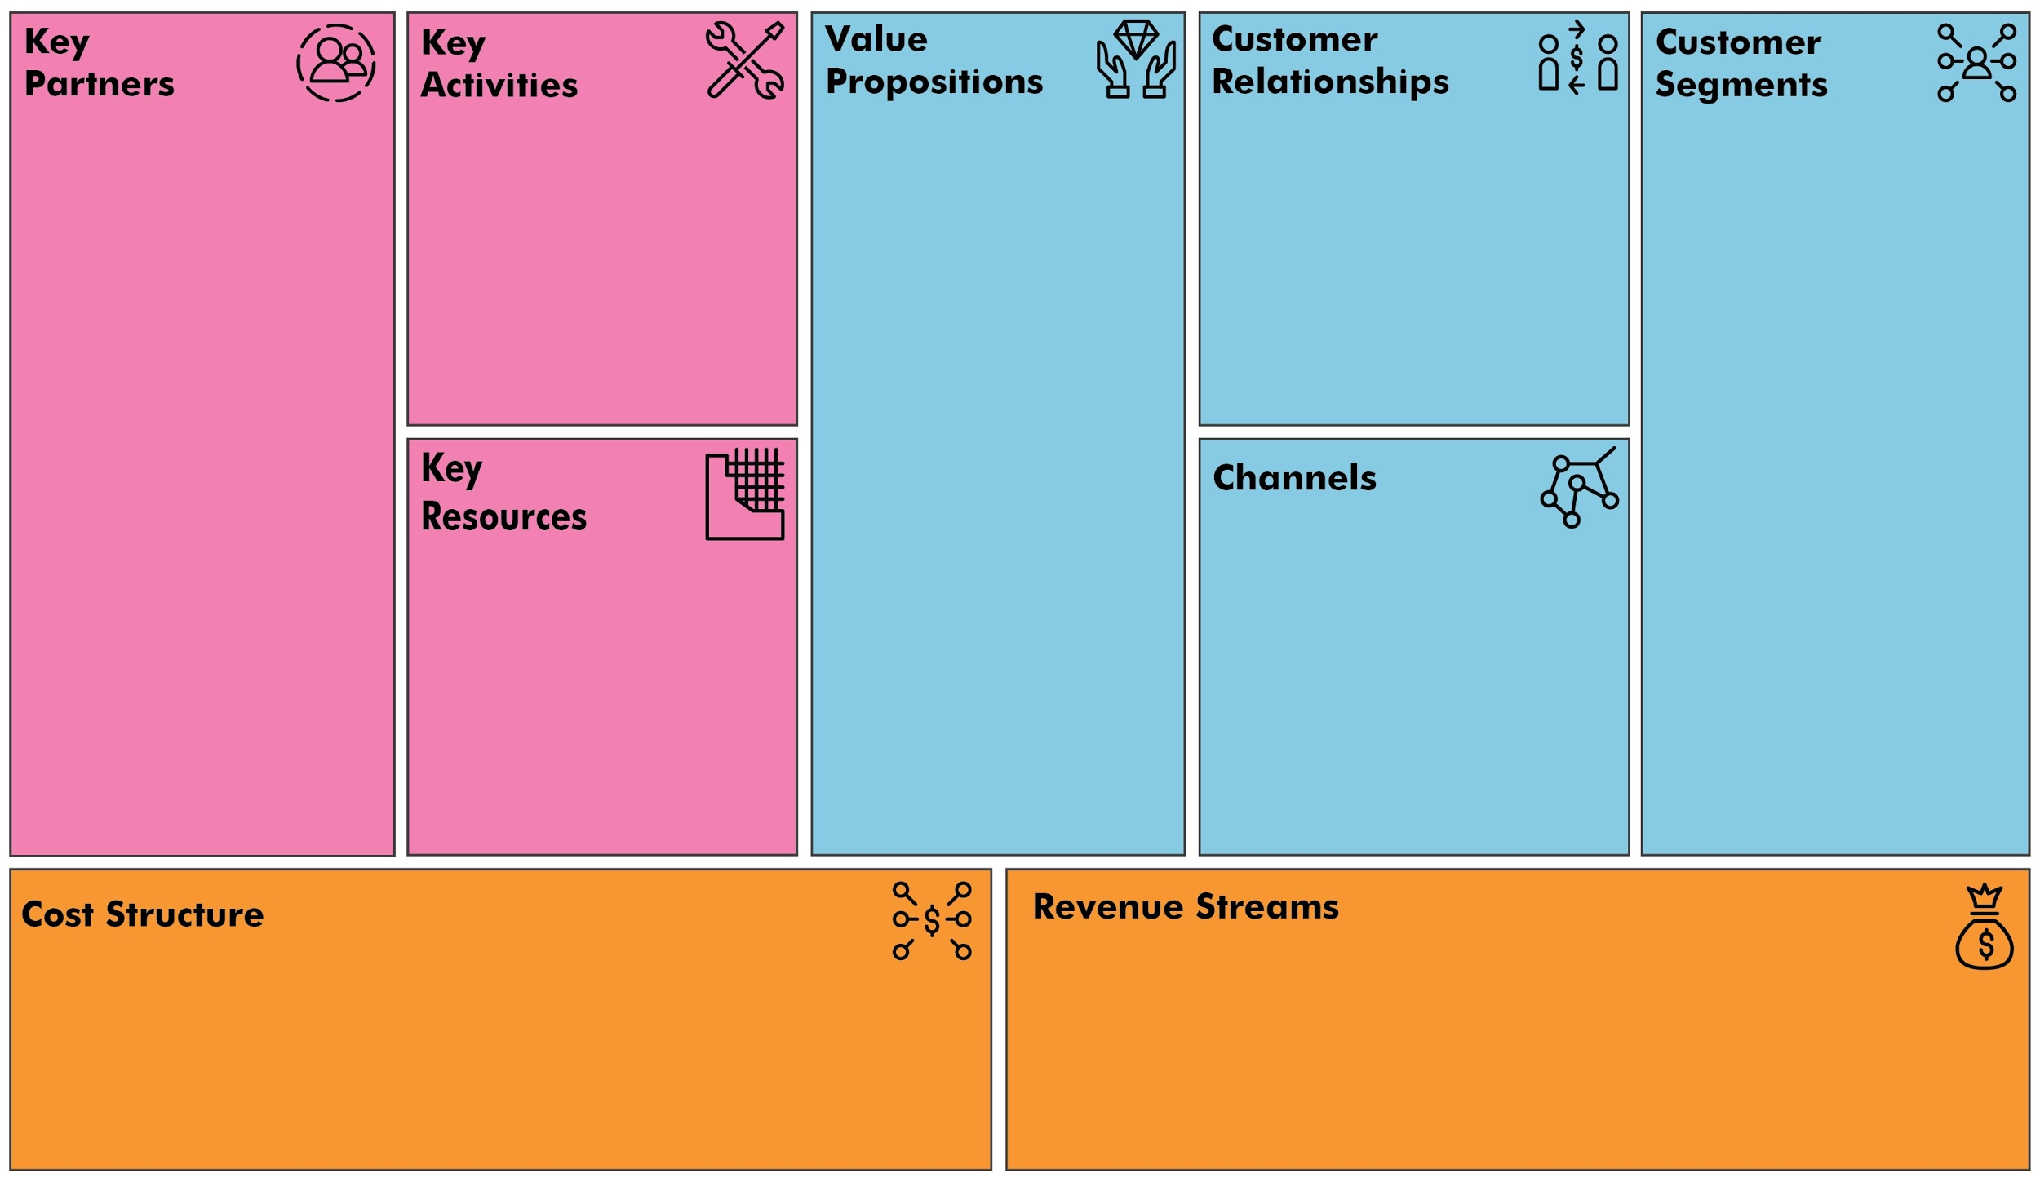
GIS Framework Vendor
Public weather data sources
Database and cloud service provider
Development
Maintenance
Help people find safer water in a convenient way
Give researcher a better insight of the data
Feedback and Improvement
People who may suffer from water salinity
Researchers who study the effect of climate change on wellness of ordinary people
Mobile App
GIS Framework
Public weather information
Cloud storage
MVP stage: free
Potential cost: Advanced GIS functions and scalable cloud service
Funds from governments, researchers and NGO
Notes:
Here is a brief overview of our business canvas model. For now, the main customer segments we can determine are ordinary people and researchers who may have interests on climate-related fields.
For value propositions, we want to help people find safer water in an easy way. And for researchers, we can provide them with a better insight of data. In the next slide, I’ll give more detailed explanation of value propositions and customer segments.
For key partners and key resources, as our project is to integrate an app with map visualization, GIS (Geographic Information System) framework is a very important part. Some GIS framework vendor, like Carto, ArcGIS, leaflet will be very important partners to our group. To construct a map with climate information, public data like weather and underground water information will be essential to our project. Also to store data, cloud service and database provider is vital to our group.
Our key activities will be mainly development of the mobile app, and after completion of app, we’ll focus on maintenance and improvement of the app.
For customer relationships, both during development of app and during practical usage of the app, we’ll need to get feedback from users to improve our project.
For the cost structure of our project. For now, at the minimal viable product stage, the cost of the project should be free. Most GIS framework, which is the key part in the project, can provide many basic and relatively complete features for free. Also if the database is small, some cloud service like Google can also provide cloud storage for free. In the future, if there’s needs to add advanced GIS features and long-term scalable cloud storage, we may have to pay for the service.
As our project is trying to make contribution to climate change problems, funds from researchers will be a big profit. Also, governments and some non-governmental organizations may be interested in our project. They might be potential customers who will pay to get our service.

Slide 8
Value Proposition & Customer Segments
Ordinary people
Help people be aware of salinity of drinking water
Help people find the nearest safe drinking water
Researchers & Government
Provide a direct way to visualize data
Get general idea of data about a certain area
Help research on climate-related topics
Give a convenient way to inspect health problem of communities
Notes:
So the main customer of our product will fall into ordinary people and researchers, including governments and NGOs.
For people in communities, our product will be a good way to help them get aware of the salinity of their drinking water, which is vital to their health.
Especially for people in coastal area, with a map showing the distribution of salinity of drinking water, they can find the nearest safe drinking water. Here safe means water with safe salinity.
For researchers and government that are caring about problems brought by climate change, our product can also be a great help. Researchers will get a direct visualization of data from our product. They can get a macro idea of data on each area. If they want to study climate-related topics, our product will give supporting data and corresponding map visualization for them. For governments, the product is also a good way to inspect the health-level of certain communities.

Slide 9
Interview with People in Bangladesh
Assumption:
Have access to smart phone and internet connection
Heavily rely on well as water resource
Suffer from water salinity
Perception of the salinity problem:
Are they aware of the problem
Have they tried to solve the problem
Notes:
One of our mobile app’s purpose is to help people in Bangladesh find safe water. But chances are that people who concern about water safety are too poor to afford those kind of thing. Therefore, we want to make sure they have access to smart phone and internet connection.
Another thing we want to confirm is that they do reply on well as their main water resource in daily life and some of them become sick due to high water salinity. This will make sure our product would be useful for them. Meanwhile, we are curious how they recognize the water salinity problem and have they tried to solve the problem. We can imagine that they might have been aware of the problem and they would go to some particular water sources known for its relatively low water salinity. If our assumption is true, then our approach of helping them find safe drinking water is exactly what they need.

Slide 10
Interview with Researchers
Assumption:
Suffer from data analysis and visualization
High frequency of usage of climate change related data
Perception of the data visualization:
Have they thought about using data visualization to gain insight from data
What kind of tools they have used
Notes:
For the interview with researchers, we make the assumptions that they may sometimes suffer from data analysis and data visualization, and they may need an integrated platform that can provide visualization of data conveniently. And we assume researchers that are interested in climate related topics will have a high frequency of usage of climate related data.
So we want to know their perception of data visualization. Like how they think about using data visualization to get an insight of data. And for now what kind of tools they used to do the data analysis, and what tools they have used to do data visualization work.

Slide 11
Q & A

Slide 12
Thanks for Listening

